Slide 1

Digital Signal Processing End Term Exams Report
Rahul Kumar(D0829006)
Department of Computer Science and Information Engineering
Chang Gung University

Slide 2
OUTLINE
Exercise
Research Work

Slide 3
Chapter-02
Exercise 01 : Write a function called stretch that takes a Wave and a stretch factor and speeds up or slows down the wave by modifying ts and framerate. Hint: it should only take two lines of code.
Solution and Setup : Result

Slide 4
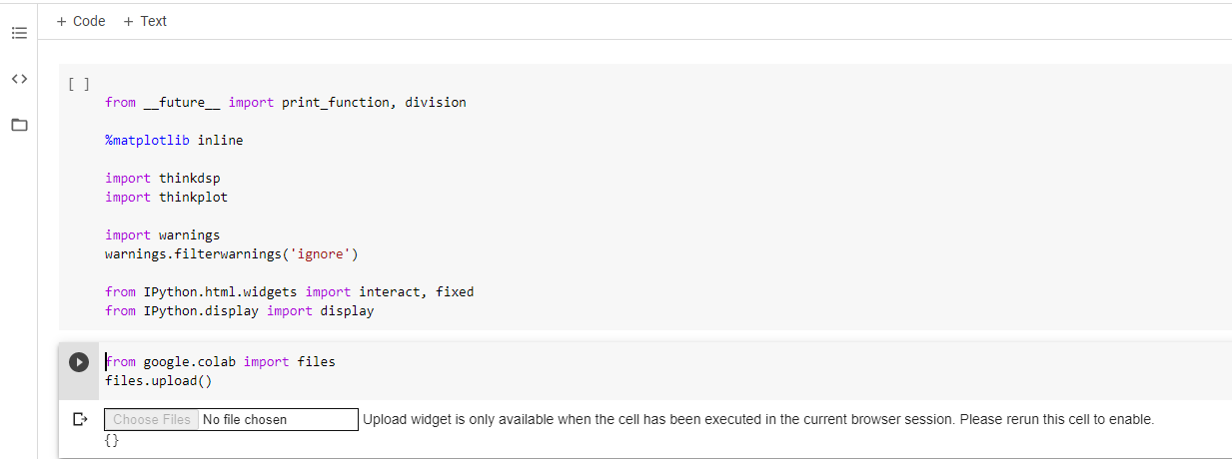
Task 01: Write a function called stretch that takes a Wave and a stretch factor and speeds up or slows down the wave by modifying ts and framerate. Hint: it should only take two lines of code.
Experimental Result
Open Google Colab
Import libraries
Use upload function for file upload

Slide 5
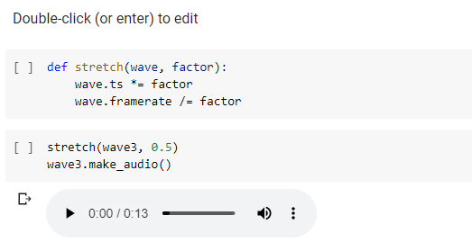
Task 01: Write a function called stretch that takes a Wave and a stretch factor and speeds up or slows down the wave by modifying ts and framerate. Hint: it should only take two lines of code.
Experimental Result
Add function : thinkdsp.py and thinkploat.py from the code file and type code and run, listen sound

Slide 6
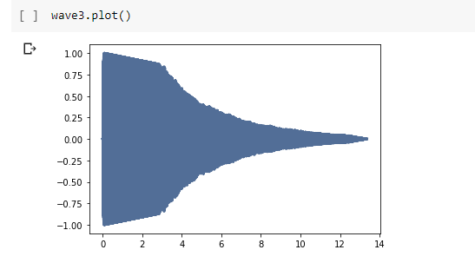
Task 01: Write a function called stretch that takes a Wave and a stretch factor and speeds up or slows down the wave by modifying ts and framerate. Hint: it should only take two lines of code.
Experimental Result
Plot wave

Slide 7
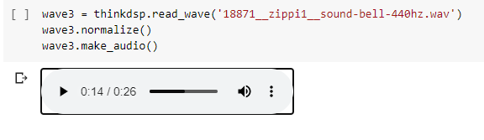
Task 01: Write a function called stretch that takes a Wave and a stretch factor and speeds up or slows down the wave by modifying ts and framerate. Hint: it should only take two lines of code.
Experimental Result
Need to change the name of sound wave file and then run , found a new graph

Slide 8
Chapter 3

Slide 9
Question#4
In musical terminology, a “glissando” is a note that slides from one pitch to another, so it is similar to a chirp. Find or make a recording of a glissando and plot a spectrogram of the first few seconds. One suggestion: George Gershwin’s Rhapsody in Blue starts with a famous clarinet glissando, which you can download from http://archive.org/details/rhapblue11924.

Slide 10
Solution
Find a recording of a glissando.
plot a spectrogram of the first few seconds.
Note: George Gershwin’s Rhapsody in Blue starts with a famous clarinet glissando, which you can download from http://archive.org/details/rhapblue11924.

Slide 11
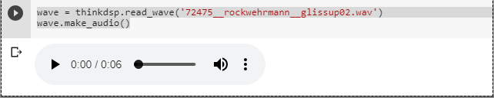
Source Code
1. Find or make a recording of a glissando.

Slide 12
def read_wave(filename='sound.wav'): """Reads a wave file. filename: string returns: Wave """ fp = open_wave(filename, 'r') nchannels = fp.getnchannels() nframes = fp.getnframes() sampwidth = fp.getsampwidth() framerate = fp.getframerate() z_str = fp.readframes(nframes) fp.close() dtype_map = {1:np.int8, 2:np.int16, 3:'special', 4:np.int32} if sampwidth not in dtype_map: raise ValueError('sampwidth %d unknown' % sampwidth) if sampwidth == 3: xs = np.fromstring(z_str, dtype=np.int8).astype(np.int32) ys = (xs[2::3] * 256 + xs[1::3]) * 256 + xs[0::3] else: ys = np.fromstring(z_str, dtype=dtype_map[sampwidth]) # if it's in stereo, just pull out the first channel if nchannels == 2: ys = ys[::2] #ts = np.arange(len(ys)) / framerate wave = Wave(ys, framerate=framerate) wave.normalize() return wave

Slide 13
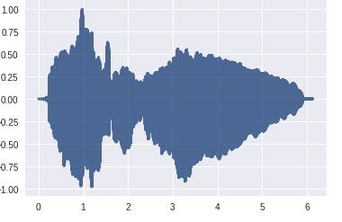
Read wave

Slide 14
Make Audio
def make_audio(self): """Makes an IPython Audio object. """ audio = Audio(data=self.ys.real, rate=self.framerate) return audio

Slide 15
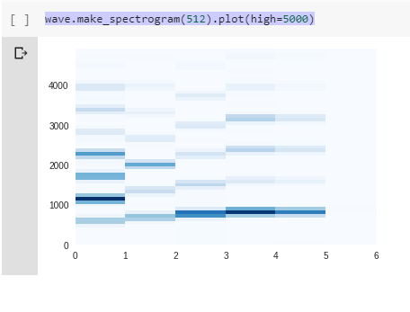
Source Code
2. plot a spectrogram of the first few seconds.

Slide 16
def make_spectrum(self, full=False): """Computes the spectrum using FFT. returns: Spectrum """ n = len(self.ys) d = 1 / self.framerate if full: hs = np.fft.fft(self.ys) fs = np.fft.fftfreq(n, d) else: hs = np.fft.rfft(self.ys) fs = np.fft.rfftfreq(n, d) return Spectrum(hs, fs, self.framerate, full)

Slide 17
Chapter-04
Exercise 4.3:
At http://www.coindesk.com you can download the daily price of a BitCoin as a CSV file. Read this file and compute the spectrum of BitCoin prices as a function of time. Does it resemble white, pink, or Brownian noise?

Slide 18

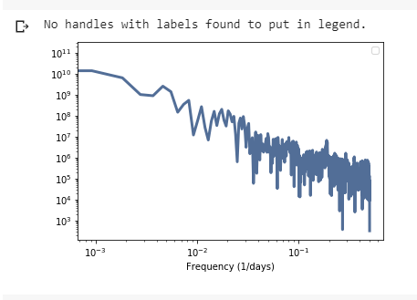
Digital Signal Processing

Slide 19
Chapter -05 Digital Signal Processing
Exercise 5.3
If you did the exercises in the previous chapter, you downloaded the historical price of BitCoins and estimated the power spectrum of the price changes. Using the same data, compute the autocorrelation of BitCoin prices. Does the autocorrelation function drop off quickly? Is there evidence of periodic behavior?

Slide 20
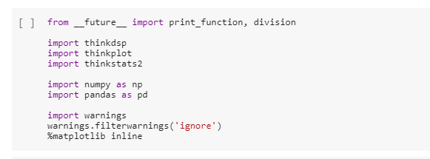
Digital Signal Processing
1.Import Packages

Slide 21
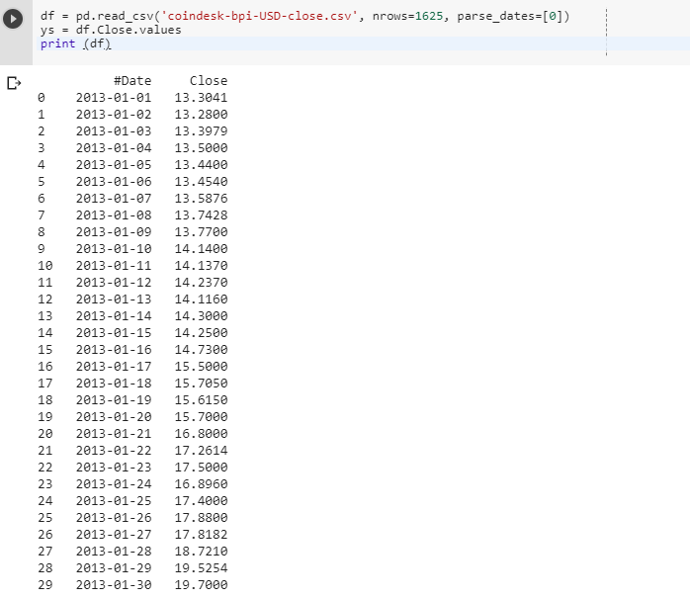

Digital Signal Processing
2. Read Csv File

Slide 22
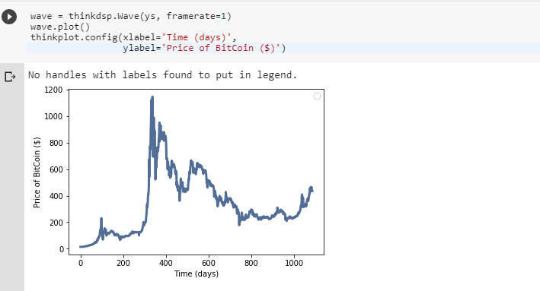
3. Power spectrum of the price changes

Slide 23
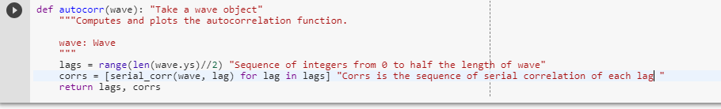
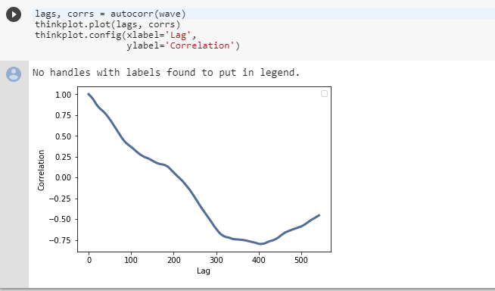
Serial_corr as a function that maps from each values of lags to the corresponding correlation
4.Autocorrelation of BitCoin prices

Slide 24
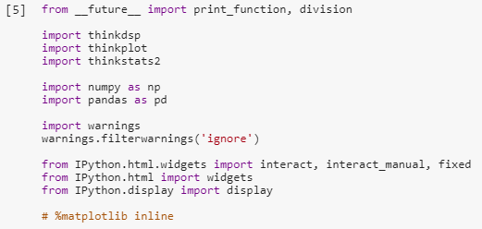
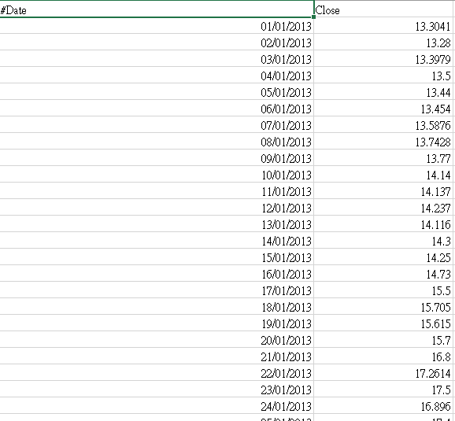
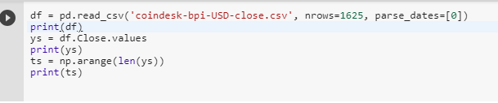

Digital Signal Processing
Output Answer:

Slide 25
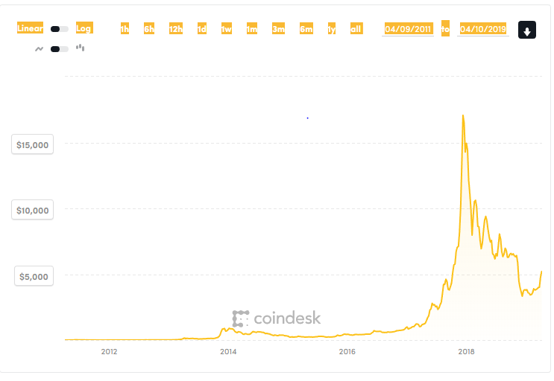

Slide 26

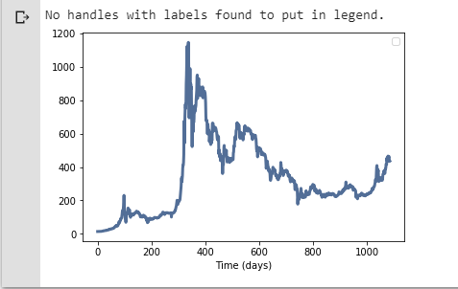
Digital Signal Processing

Slide 27
Digital Signal Processing
4.Autocorrelation of Bitcoin prices

